Slide 1
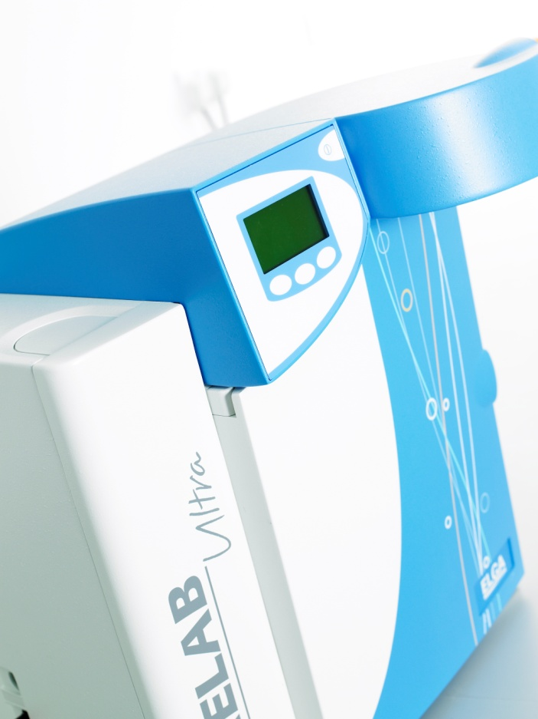
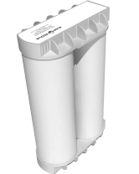
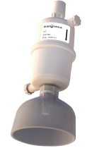
PURELAB® Ultra Scientific*
LC182/LC183 LC184/LC185
DI pack
Lifetime expectancy: 6 months
What is purified from the water?
Ions
Impact of not changing:
Weakly bound ions are released back into the water reducing resistivity
LC134
Point of Use Filter**
Lifetime expectancy: 6 months
What is purified from the water?
Particulates and bacteria
Impact of not changing:
Potential recontamination of purified water and reduced flow rates
*A combination of treatments and technologies produce the final water specification ** For DNA, RNA & endotoxin specification at point of use, please use a LC197 Biofilter
For more information please contact your local ELGA water specialist:
 +44 020 3567 7300
 info@elgalabwater.com
For more information please contact your local ELGA water specialist.
ELGA is the global laboratory water brand name of Veolia Water Technologies. The information contained in this document is the property of VWS (UK) Ltd, trading as ELGA LabWater, and is supplied without liability for errors or omissions. © VWS (UK) Ltd. 2016 – All rights reserved. ELGA®, PURELAB® are registered trademarks of VWS (UK) Ltd.

