Slide 1
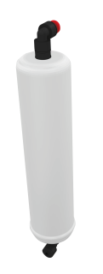
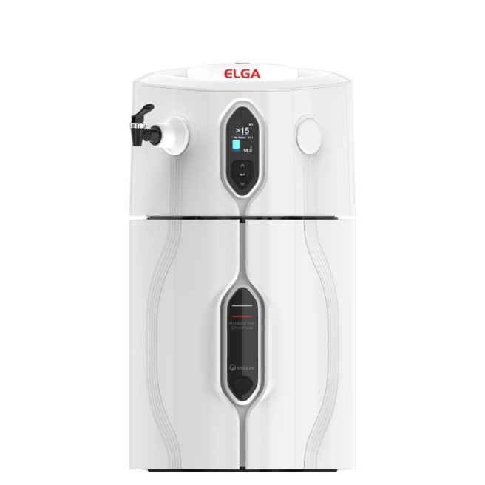
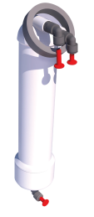
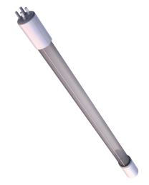
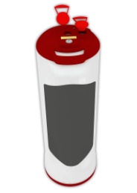
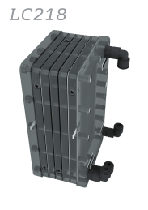
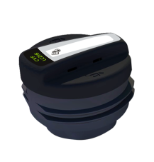
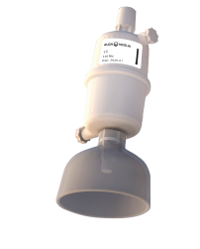
Pre-treatment
Lifetime expectancy: 6 months
What is purified from the water?
Chlorine and particulates
Impact of not changing:
Chlorine, chloramine and organics remain increasing the burden on downstream consumables which will need more frequent and expensive changes
LC241
PURELAB® Chorus 2+ RO/EDI/UV*
Reverse Osmosis
Lifetime expectancy: 24-36 months
What is purified from the water?
Majority of organics and inorganics
Impact of not changing:
High levels of organics and inorganics remain in the water reducing the functional life of the DI pack
LC240
LC285
UV light
Lifetime expectancy: 12-18 months
What is purified from the water?
Inactivates DNA and RNA
Impact of not changing:
Uncontrolled bacterial contamination
LC243
Optimizer Pack
Lifetime expectancy: 6 months
What protection does it provide?
Reduces calcium and magnesium hardness deposits on
EDI stack
Impact of not changing:
Irreversible damage to the EDI stack
LC277
EDI Stack
Lifetime expectancy: 4-5 years
What is purified from the water?
Ions
Impact of not changing:
Ions will remain in the water
LC216
LC145
Composite Vent Filter
Lifetime expectancy: 6 months
What protection does it provide?
Reduces CO₂ and airborne organics from entering the sealed system
Impact of not changing:
Increase in airborne contaminants and potential recontamination of purified water
Point-of-Use Filter**
Lifetime expectancy: 3 months
What is purified from the water?
Particulates and bacteria
Impact of not changing:
Potential recontamination of purified water and reduced flow rates
*A combination of treatments and technologies produce the final water specification ** For DNA, RNA & endotoxin specification at point of use, please use a LC197 Biofilter
For more information please contact your local ELGA water specialist:
 (877)-315 3542
 Elga.orders@veolia.com
For more information please contact your local ELGA water specialist.
ELGA is the global laboratory water brand name of Veolia Water Technologies. The information contained in this document is the property of VWS (UK) Ltd, trading as ELGA LabWater, and is supplied without liability for errors or omissions. © VWS (UK) Ltd. 2016 – All rights reserved. ELGA®, PURELAB® are registered trademarks of VWS (UK) Ltd.

